Slide 1
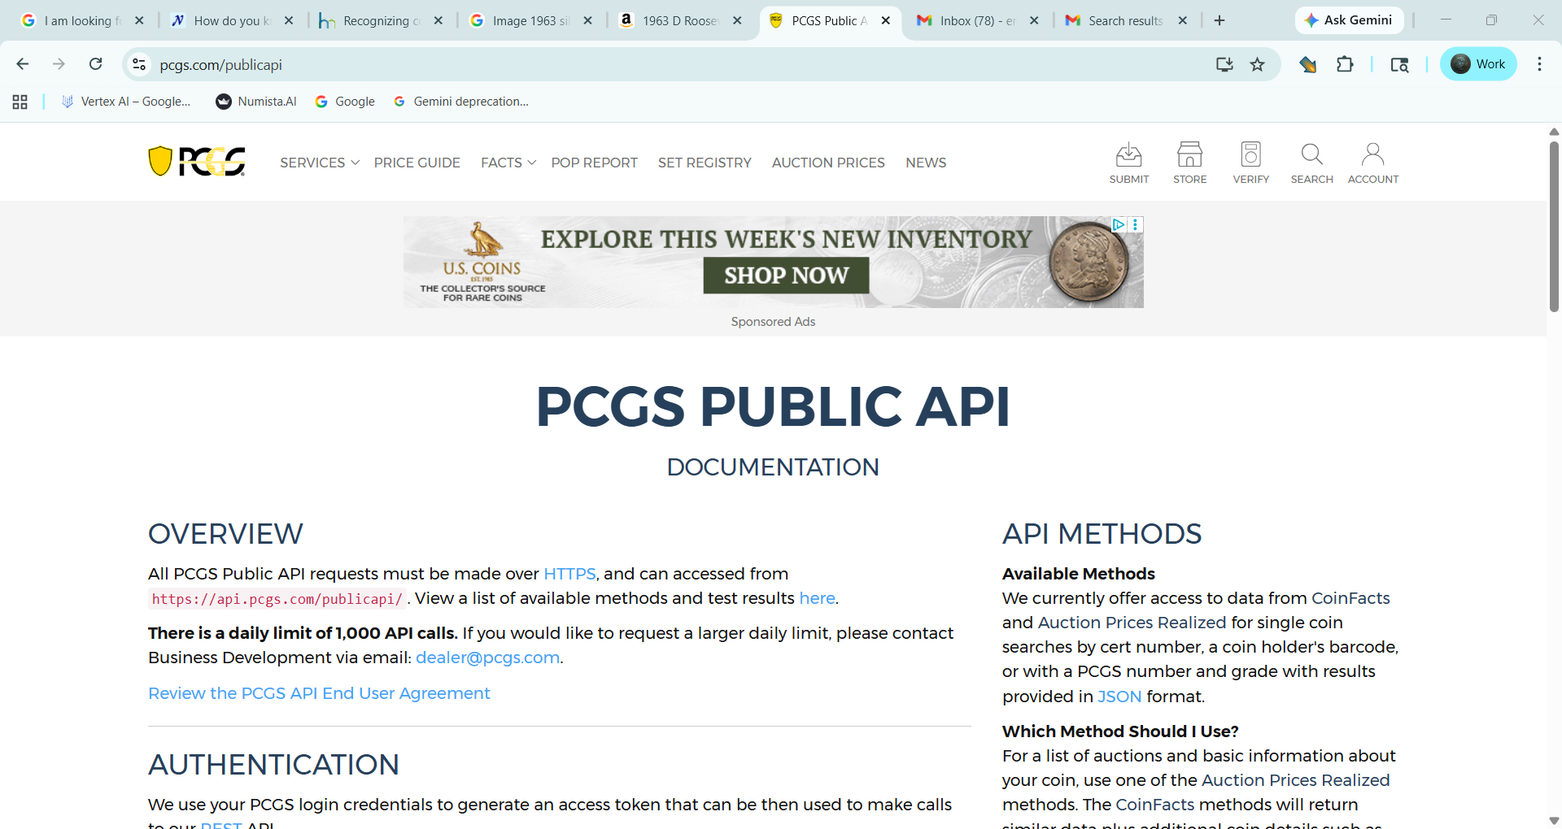

Slide 2
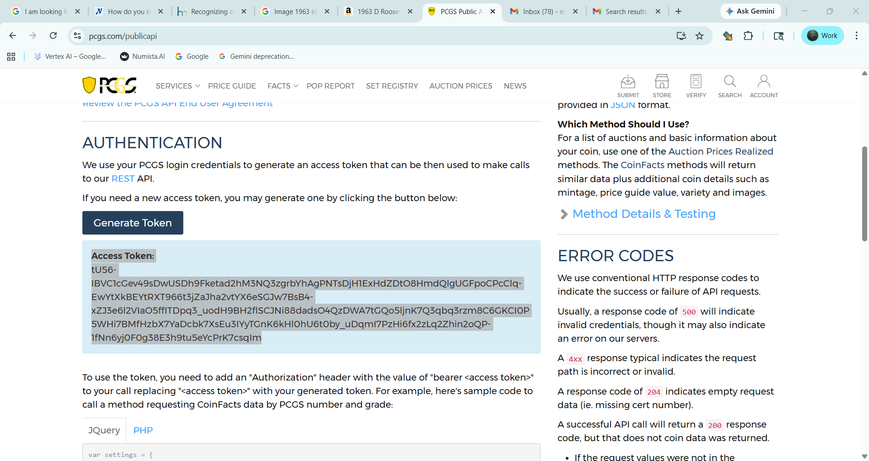

Slide 3
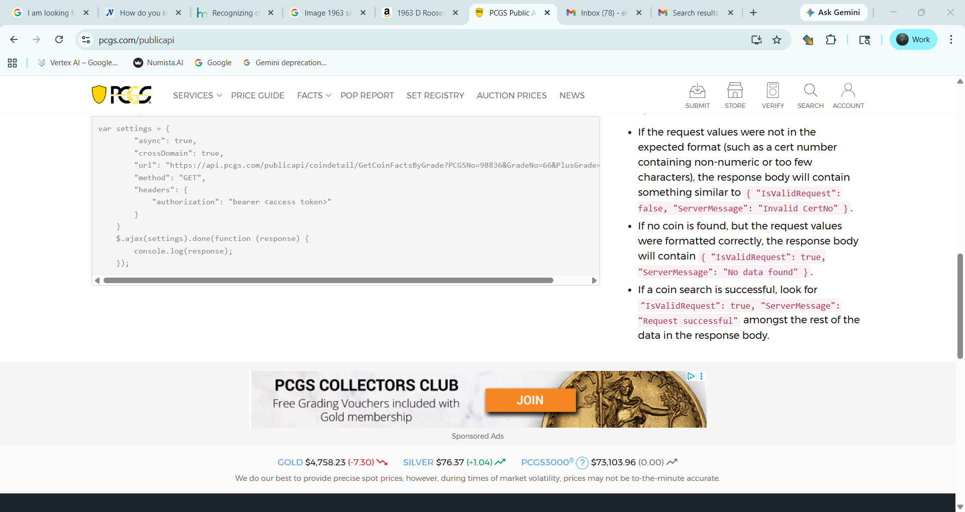

Slide 4
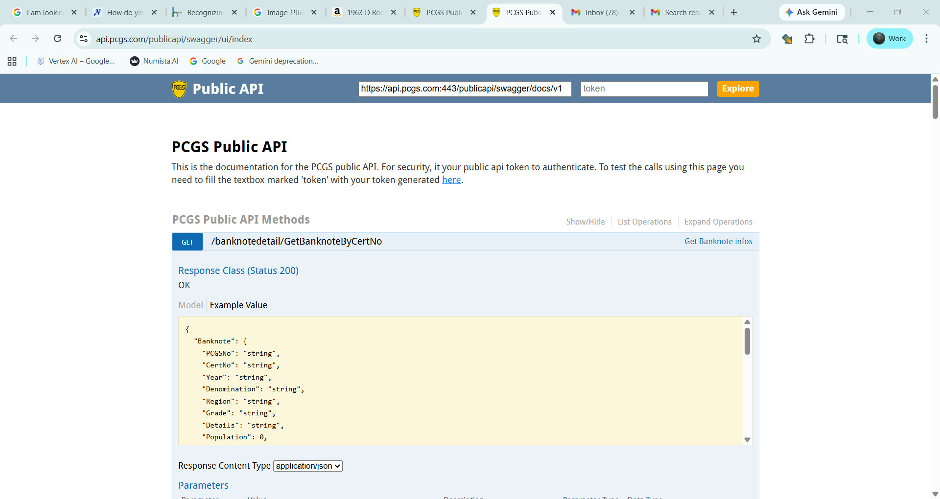

Slide 5
PCGS: email: eric@numista.ai PW: Ericds#112026LFG! Access Token: tU56-IBVC1cGev49sDwUSDh9Fketad2hM3NQ3zgrbYhAgPNTsDjH1ExHdZDtO8HmdQlgUGFpoCPcClq-EwYtXkBEYtRXT966t3jZaJha2vtYX6eSGJw7BsB4-xZJ3e6l2VIaO5ffITDpq3_uodH9BH2flSCJNi88dadsO4QzDWA7tGQo5ljnK7Q3qbq3rzm8C6GKCI0P5WHi7BMfHzbX7YaDcbk7XsEu3IYyTGnK6kHl0hU6t0by_uDqmI7PzHi6fx2zLq2Zhin2oQP-1fNn6yj0F0g38E3h9tu5eYcPrK7csqIm

